Slide 1
SCHOOL DATA
Yalcin Udun, Bilal Dogan

Slide 2


BACKGROUND
Parents want to see school performance measured. They look for concrete evidence of school quality; therefore, there is an increased focused on student achievement data(BMS, 2013).
Parents pay thousands of dollars extra to live near schools with high achieving scores (Ferguson, 2015).
Schools with high test scores are favored by the parents. Is the success a result of being good school, or are there other factors in place in the environment?
The purpose of the research was to examine the relationships between measures of outside environment and student outcome (reading, mathematics, and self-esteem).
This study aims to help parents to understand what environmental factors play on school success.
Notes:
The purpose of the research was to examine the relationships between measures of support outside the school(education and counseling) and student outcome (reading, mathematics, and self-esteem).

Slide 3

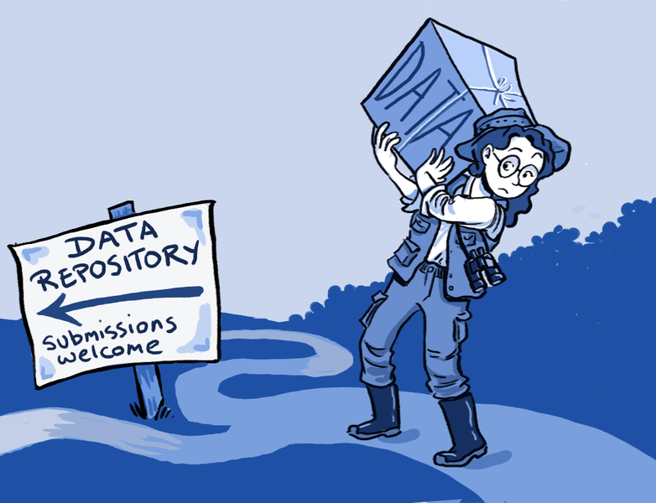
DATA COLLECTION
School Data, from Charnes et al. (1981).
N=70 school districts
Outcome variables
Reading: Total reading score as measured by the Metropolitan Achievement Test
Mathematics: Total mathematics score as measured by the Metropolitan Achievement Test
Self-esteem: Coopersmith Self-Esteem Inventory, intended as a measure of self-esteem
Input Variables
Education: Education level of mother as measured in terms of percentage of high school graduates among female parents
Parental Involvement: Parent counseling index calculated from data on time spent with child on school-related topics such as reading together, etc.
Visit
Counseling
Notes:
The data set is from the US federally sponsored program for providing remedial assistance to disadvantaged primary school students from Charnes et al (1981), and it was installed in R. The firms are 70 school sites, and data are from entire sites.

Slide 4

CHECKING ASSUMPTIONS
Normality
Mardia Skew
Mardia Kurtosis
Outliers
Mahalanobis Distance
Notes:
The data did not meet the normal-distribution assumptions. There was an outlier detected. One outlier had a value of 139%, which is more than the acceptable value of 100%. It was removed from the study because of the incorrect amount. The data was tested without the outliers. It was skewed; however, it was not significantly kurtosis. The data was very close to the normal distribution.

Slide 5

RESULTS
These two sets of variables are highly correlated (r=0.98).
Students receive supports outside the schools tend to do better at school.
Notes:
At least one major result is reported, and report includes statistical significance (e.g., test statistic, p-value, and alpha level), as well as effect size (e.g., eta-squared for MANOVA, omega for factor reliability, etc.) or sample characteristics (e.g., mean change scores on all DVs).
Statistical significance and effect size/sample characteristics are interpreted correctly and completely

Slide 6
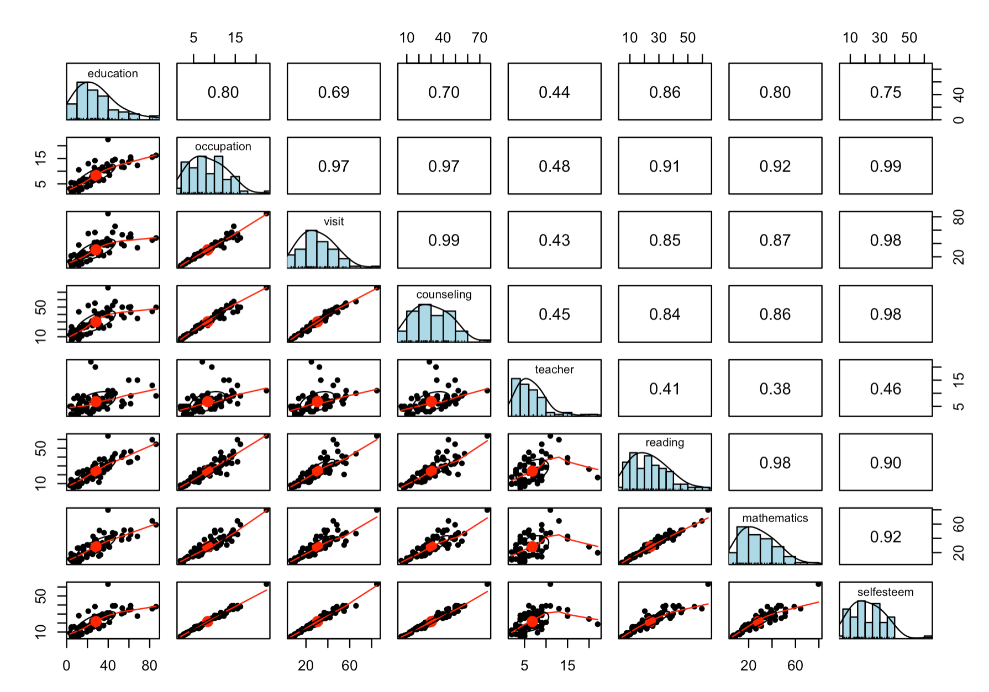
Data Exploration

Slide 7

Data Analysis
Linear Regression
Check for Linearity between self esteem and education, occupation, visit, counselling, teacher.
Stepwise (Backward Approach) Linear Regression for cross validation
Run this model to see if we come up with the same results
Cluster analysis (explore other possibilities)
Identify clusters
Run PCA analysis with Biplot graph to make sense of clusters.

Slide 8

Linear Regression
Call:
lm(formula = schooldata$selfesteem ~ education + occupation +
visit + counseling, data = schooldata[, 1:5])
Residual standard error: 1.164 on 66 degrees of freedom
Multiple R-squared: 0.993, Adjusted R-squared: 0.9927
F-statistic: 3129 on 3 and 66 DF, p-value: < 2.2e-16
self-esteem = 0.16 - 0.05(education) + 2.26(occupation) + 0.22(visit) - 0.09(counseling)

Slide 9
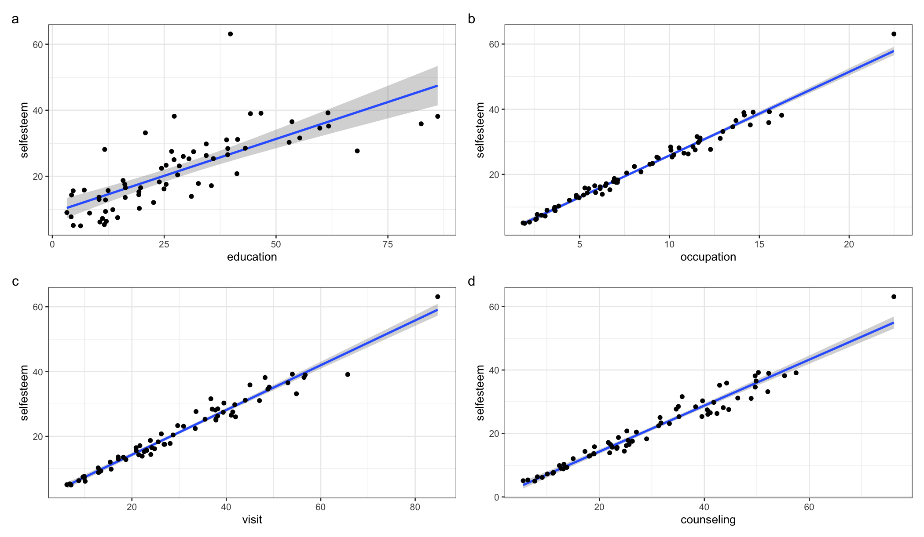
Individual Relationships

Slide 10
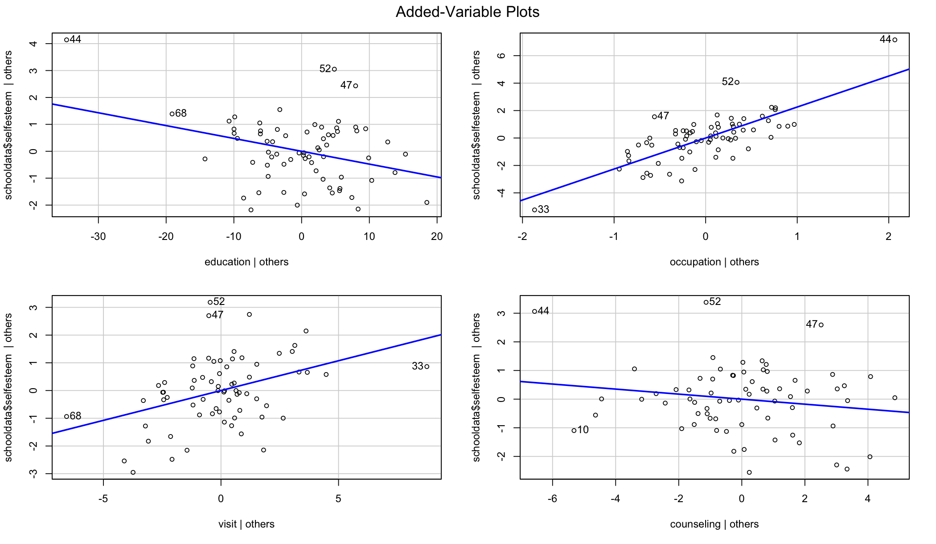
Linear / Stepwise Regression Model

Slide 11

K-means Cluster Analysis
Investigate the number of clusters with "kmeans" clustering method as all the values are all continues numbers.
wss method
k1 <- fviz_nbclust(schooldata.scaled, kmeans, method = "wss") + labs(title = "WSS Method")
Silhouette Method
k2 <- fviz_nbclust(schooldata.scaled, kmeans, method = "silhouette") + labs(title = "Silhouette Method")
Gap Stat Method
gap_stat <- clusGap(schooldata.scaled, FUN = kmeans, nstart = 25, K.max = 10, B = 10)
k3 <- fviz_gap_stat(gap_stat) + labs(title = "Gap Stat Method")

Slide 12
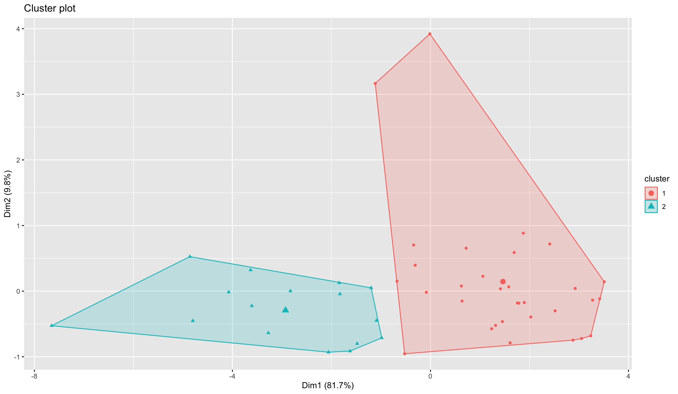
Plotting the Clusters
Kmeans2 <- kmeans(train, centers = 2, nstart = 25, iter.max = 100)
fviz_cluster(Kmeans2, geom= "point", data = train)

Slide 13
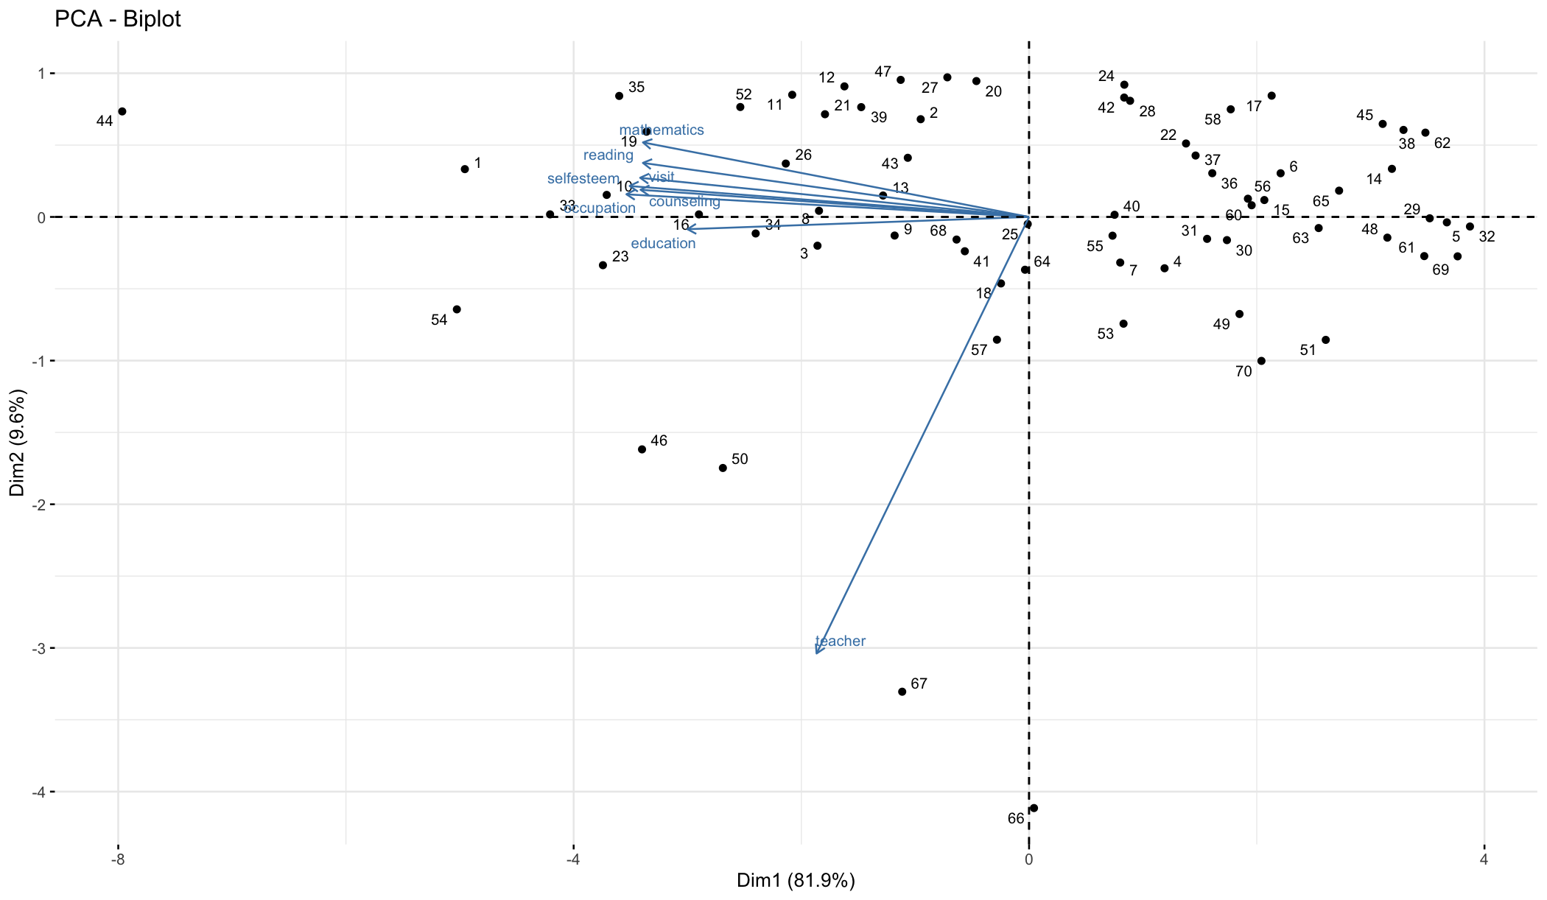
Run PCA Analysis and Biplot

Slide 15

Findings
Visits and Occupation have the highest effect on student self-esteem along with student achievement.
Number of teachers has no effect on student self-esteem nor student achievement.
Environmental factors play an important role on high academic achievement
Two clusters were found.
One with high achievement scores along with high environmental scores.
The other one with low achievement scores along with low environmental scores.

